Slide 1



AI-Driven Phishing Email Detection Using NLP (Natural Language Processing)
Machine Learning | Text Classification
Presented By :
Student Name : Aakash Institute Name: VIPS-TC Institute Roll no.: 04517702723 Enrollment no.: 775314
Summer Internship Program in AI & ML 2026 | Indian Institute of Computing and Technology (IICT)

Slide 2
Problem Statement & Project Objective
Problem Statement
Millions of emails are sent every day.
Some emails are phishing , or spam.
Manual email checking is difficult and time-consuming.
An AI system is needed to automatically detect phishing emails.
Why It Is Important ?
Email Communication
Cyber Security
Phishing Attacks
AI Detection
Project Objective
Build a Machine Learning model that automatically classifies emails as Legitimate (Ham) or Phishing (Spam) using NLP and compare different ML models to find the best performer.
Summer Internship Program in AI & ML 2026 | Indian Institute of Computing and Technology (IICT)

Slide 3
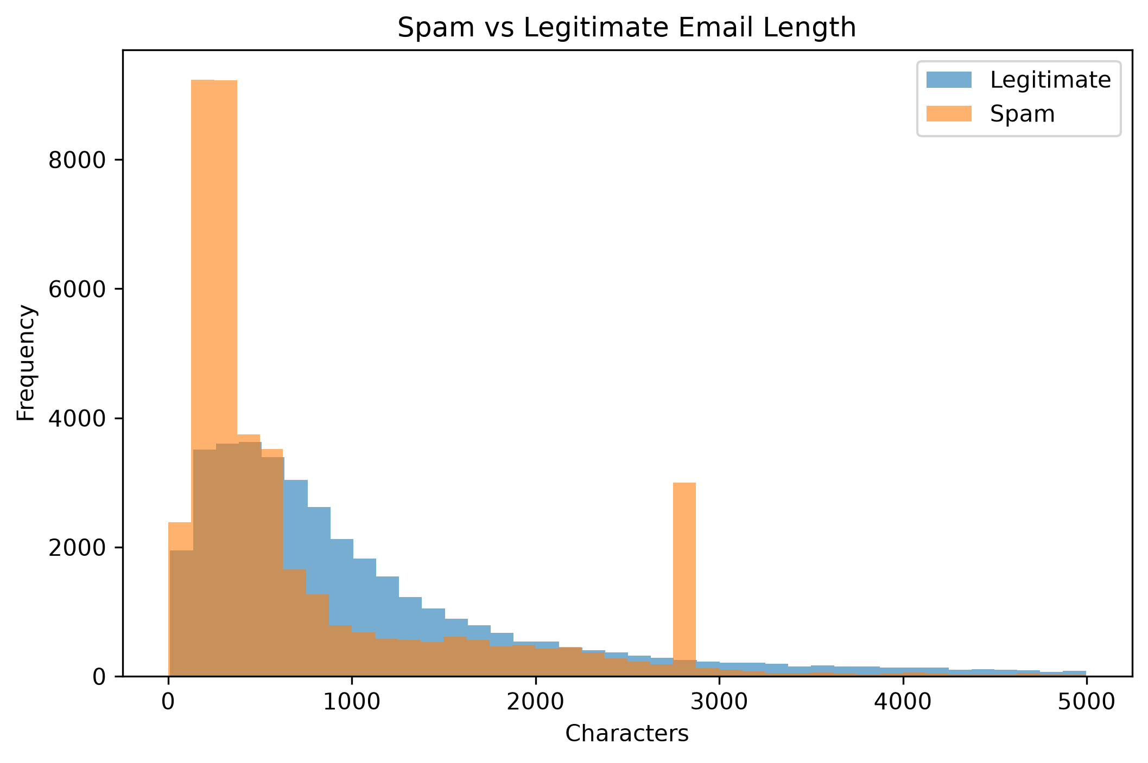
Dataset Overview
Dataset Summary
Total Records : 82,078
Total Features : 2
Legitimate (Ham) = 0
Spam (Phishing) = 1
Features Used
Email Text
Label
Label 0 → Legitimate
Label 1 → Spam
Source: Kaggle Phishing Email Dataset
Key Observation
Dataset contains both Legitimate and Spam emails.
Clean and balanced dataset for model training.
Suitable for Machine Learning classification.
Summer Internship Program in AI & ML 2026 | Indian Institute of Computing and Technology (IICT)

Slide 4
DATA PREPROCESSING
Data Cleaning Steps
Checked missing values
Removed duplicate records
Converted text to lowercase
Removed special characters
Removed numbers
Removed extra spaces
Removed stop words
Created clean text column
Workflow
Raw Email Dataset
Missing Value Check
Remove Duplicate Emails
Convert Text to Lowercase
Remove Special Characters & Numbers
Remove Stop Words
Clean Email Text
Output Clean dataset ready for TF-IDF feature extraction and Machine Learning model training.
Summer Internship Program in AI & ML 2026 | Indian Institute of Computing and Technology (IICT)

Slide 5
FEATURE ENGINEERING USING NLP
Email Text
Clean Email Text
TF-IDF Vectorizer
Feature Matrix (5000 Features)
Machine Learning Models
Output
Convert email text into numerical features
TF-IDF gives more importance to meaningful words
Feature matrix used to train all ML models
Summer Internship Program in AI & ML 2026 | Indian Institute of Computing and Technology (IICT)

Slide 6
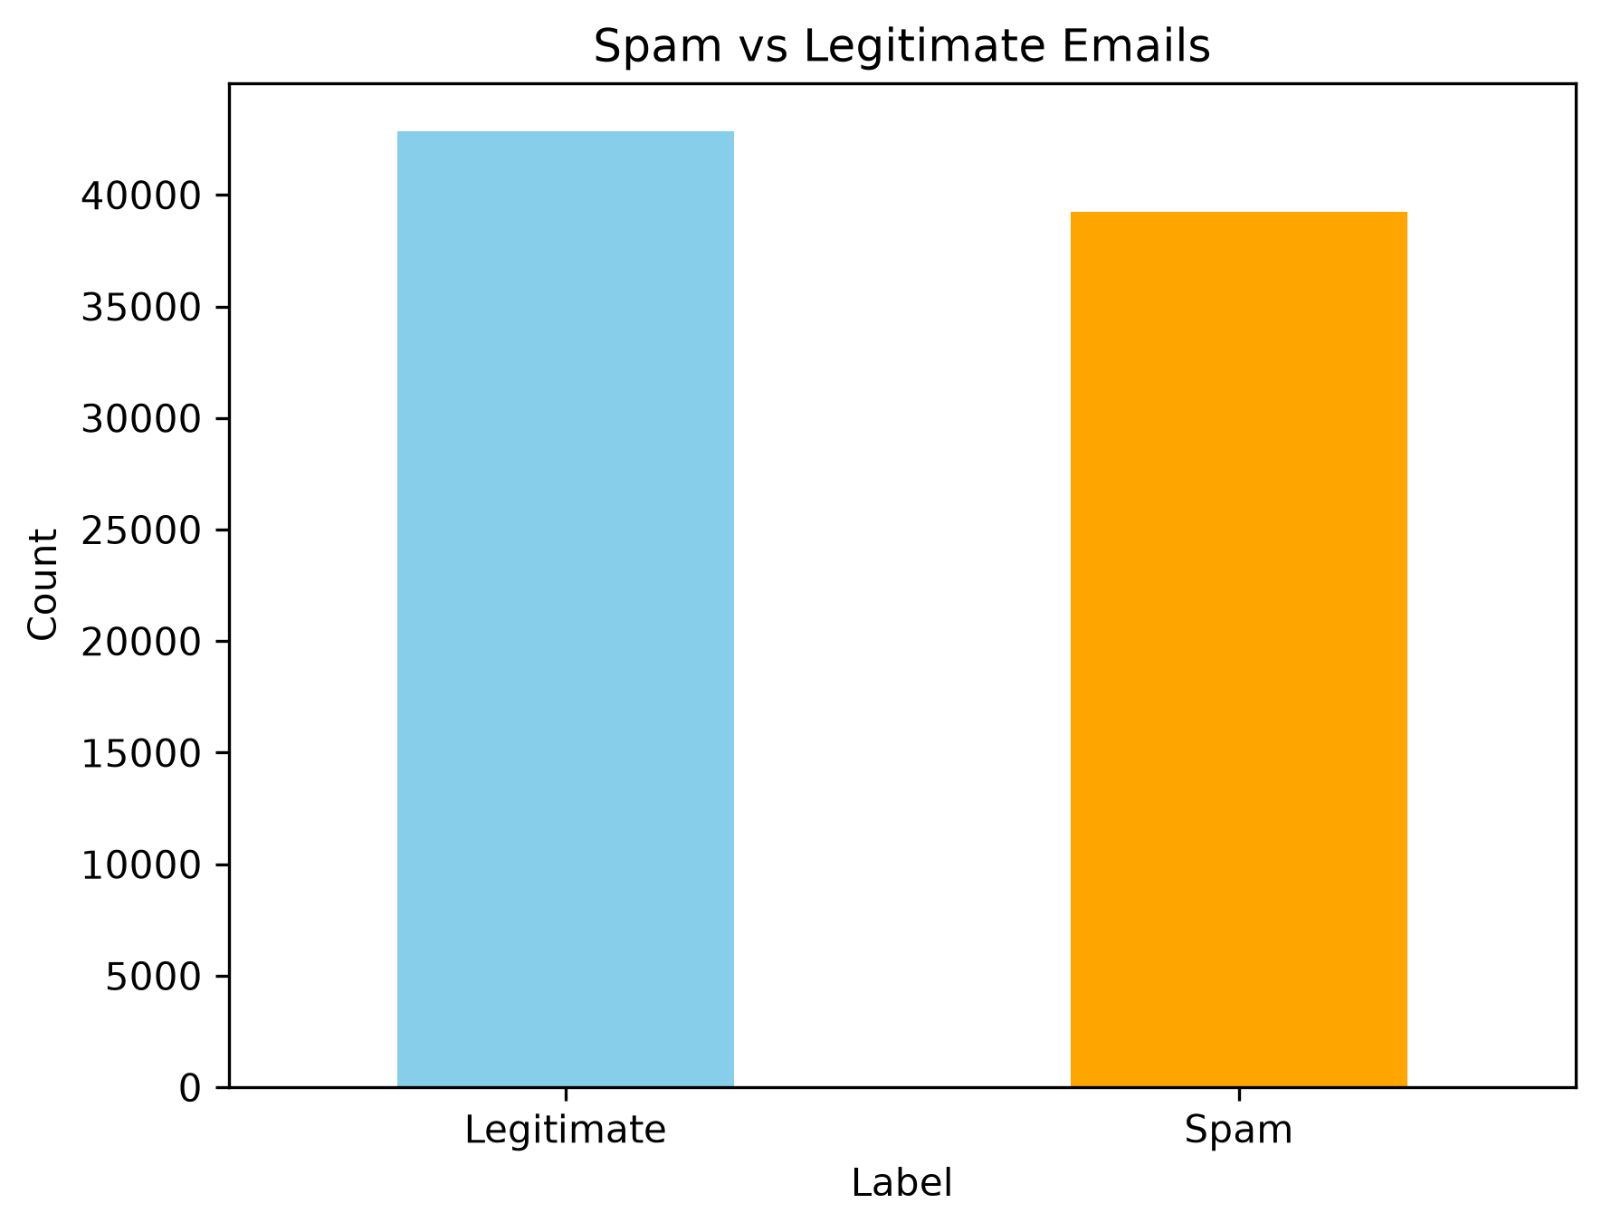
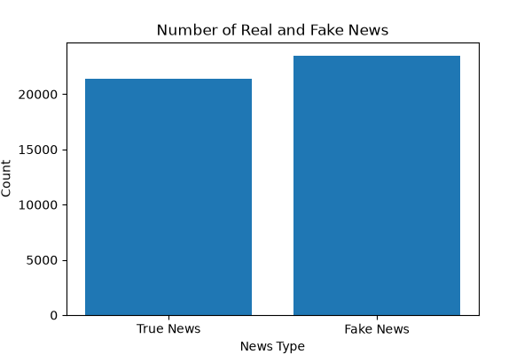
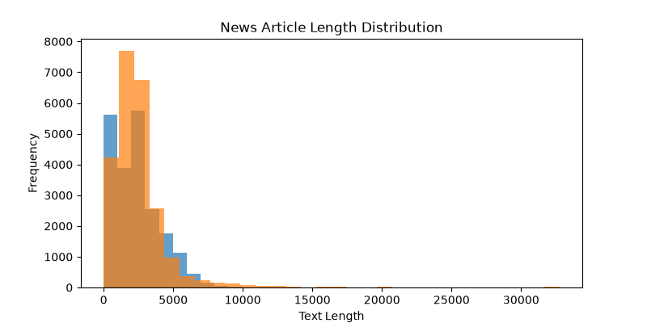
EXPLORATORY DATA ANALYSIS (EDA)
Key Insights
Spam and Legitimate emails are well represented.
Email length varies between the two classes.
EDA helped understand the dataset before model training.
Summer Internship Program in AI & ML 2026 | Indian Institute of Computing and Technology (IICT)

Slide 7
MACHINE LEARNING WORKFLOW
Email Dataset
Data Preprocessing
TF-IDF Feature Extraction
Train-Test Split(80 : 20)
Train Machine Learning Models
Model Evaluation
Best Model Selection
Summer Internship Program in AI & ML 2026 | Indian Institute of Computing and Technology (IICT)

Slide 8
MACHINE LEARNING MODELS
Logistic Regression
(Linear Classification)
Naive Bayes
(Probability Based)
Model Selection Strategy
Same Dataset
Same TF-IDF Features Same Train/Test Split
Compare Accuracy of All Models
MLP Classifier (Neural Network Approach )
Random Forest (Ensemble Learning)
Summer Internship Program in AI & ML 2026 | Indian Institute of Computing and Technology (IICT)

Slide 9
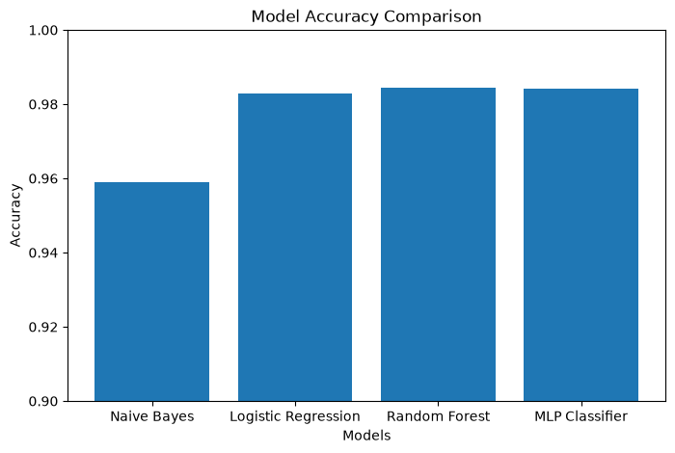
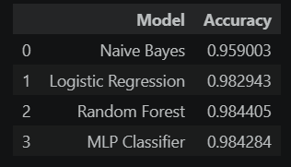
MODEL PERFORMANCE COMPARISON
Best Model
Highest Accuracy (98.44%)
Better Prediction Performance
Selected as Final Model
Summer Internship Program in AI & ML 2026 | Indian Institute of Computing and Technology (IICT)

Slide 10

BEST MODEL & FINAL RESULTS
Final Outcome
Email Message
Random Forest Model
Legitimate Email / Spam Email
BEST MODEL
Why Random Forest?
Highest Accuracy
Better Precision, Recall & F1-Score
More Reliable Predictions
Selected as Final Model
Summer Internship Program in AI & ML 2026 | Indian Institute of Computing and Technology (IICT)

Slide 11
REAL-WORLD APPLICATIONS
Email Service Providers
(Automatically filter spam emails)
Business Organizations
(Protect employees from phishing attacks )
Web & Email Applications
(Real-time phishing email detection )
Educational Institutions (Secure student and staff email systems )
Cybersecurity Systems (Detect malicious emails before delivery)
Summer Internship Program in AI & ML 2026 | Indian Institute of Computing and Technology (IICT)

Slide 12
FUTURE SCOPE
Larger & More Diverse Email Datasets
Advanced Deep Learning Models (LSTM, BERT, Transformer)
Real-Time Email Detection
Browser Extension / Email Plugin
URL, Sender & Attachment Analysis
Cloud-Based Deployment
Summer Internship Program in AI & ML 2026 | Indian Institute of Computing and Technology (IICT)
7

Slide 13
CONCLUSION
Problem Identified
Data Prepared & Cleaned
Multiple ML Models Trained
Random Forest Selected
Phishing Emails Successfully
PROJECT ACHIEVEMENT
Developed an AI-based Phishing Email Detection System
Compared multiple Machine Learning models
Achieved 98.44% prediction accuracy
Project objective successfully achieved
Random Forest Accuracy: 98.44%
The project objective was successfully achieved by building an AI-based Phishing Email Detection System with high accuracy.
Summer Internship Program in AI & ML 2026 | Indian Institute of Computing and Technology (IICT)

Slide 14
THANK YOU
Summer Internship Program in AI & ML 2026 | Indian Institute of Computing and Technology (IICT)

